Slide 1
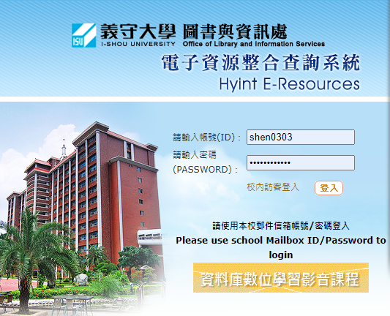
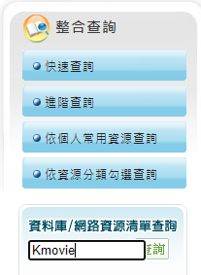
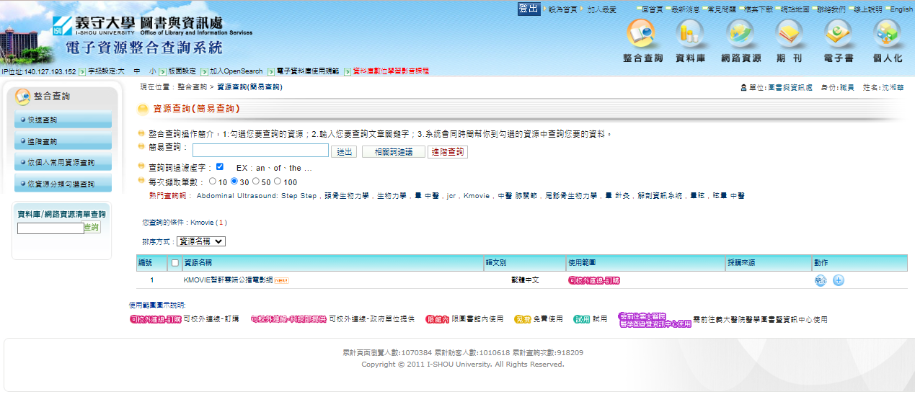
如何使用線上影音平台Kmovie?
Step1
Step2
Step3輸入應用資訊系統帳密
Step4搜尋Kmovie
Step5點擊進入Kmovie
Step6
點擊進入影片
Step7
點擊立即播放
Notes:
Kmovie中文版操作手冊

Slide 2
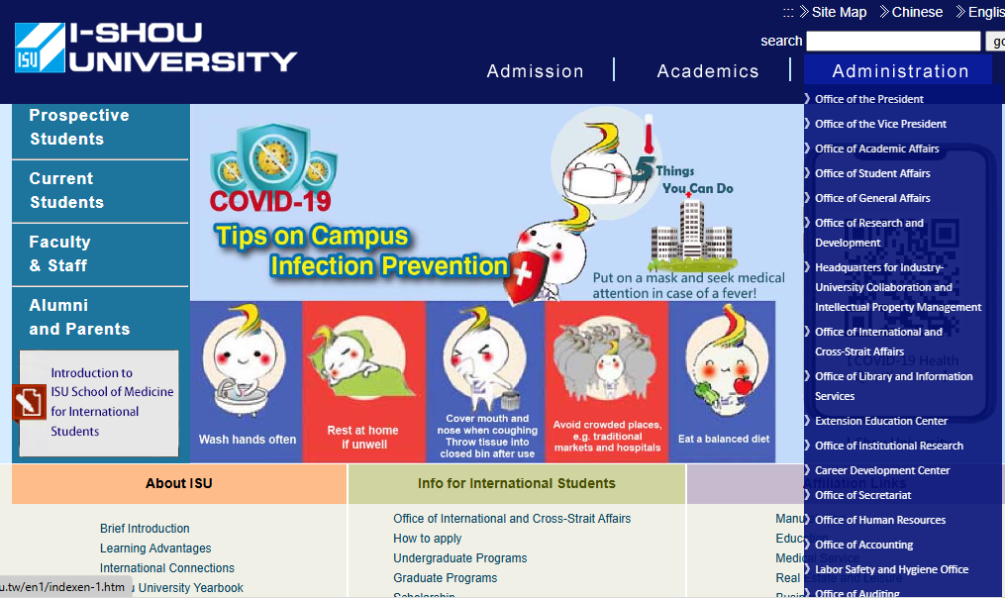
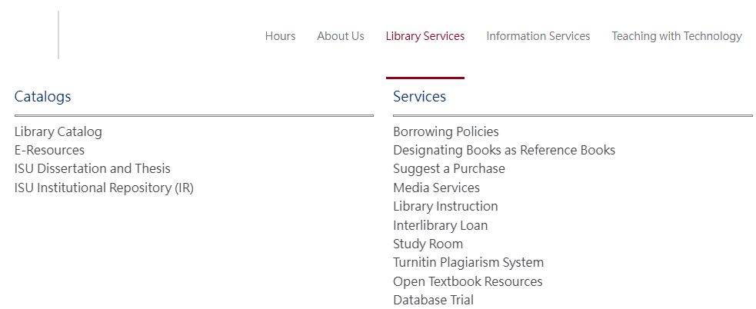
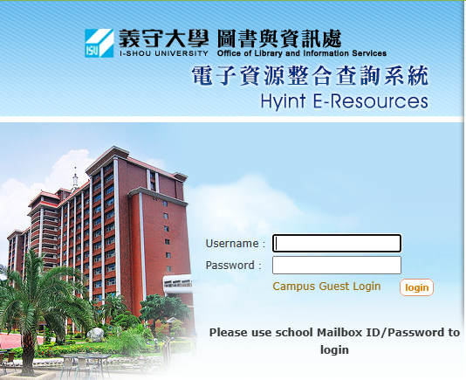
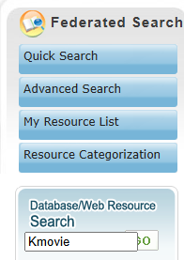
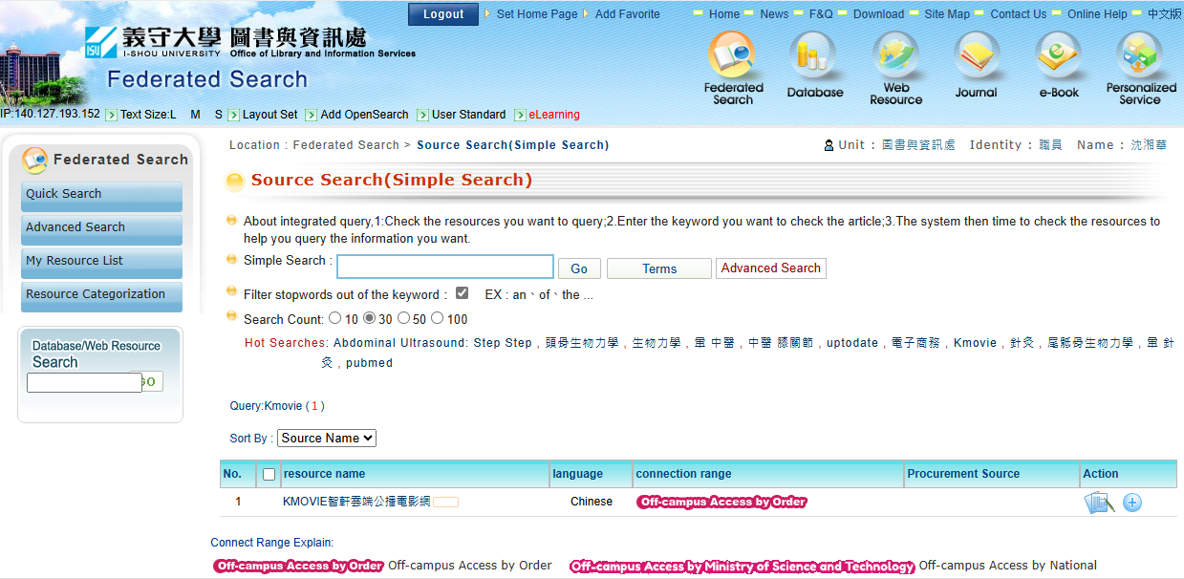
How to use online video platform Kmovie?
Step1
Step2
Step3 Enter Information System Account and Password
Step4 Search Kmovie
Step5 Click Kmovie
Step6 Click movie
Step7
Click play
Notes:
Kmovie英文版操作手冊

